Slide 1
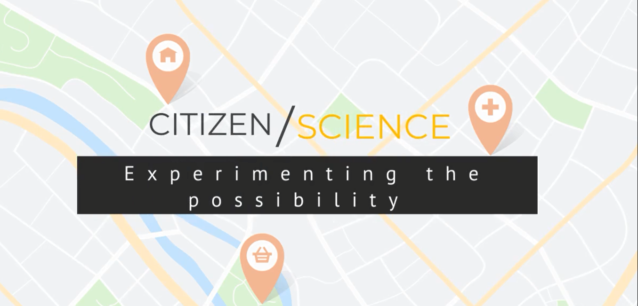

Challenge
How might we create a citizen science experiment to support a better understanding of what is happening in the State of Victoria?

Slide 2
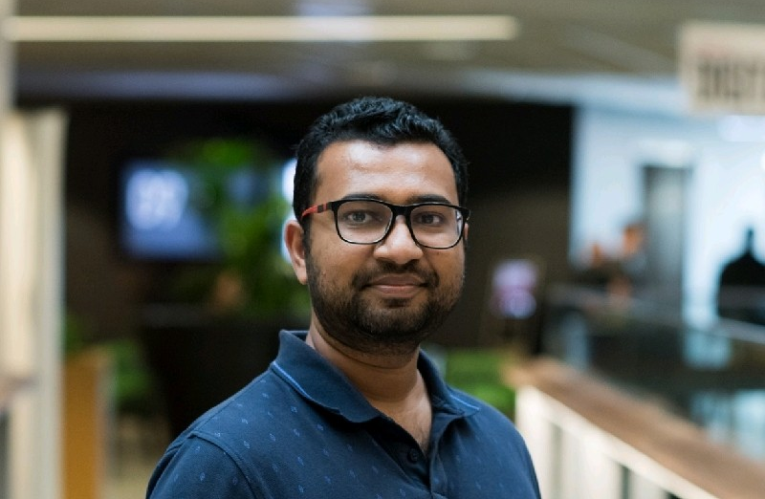
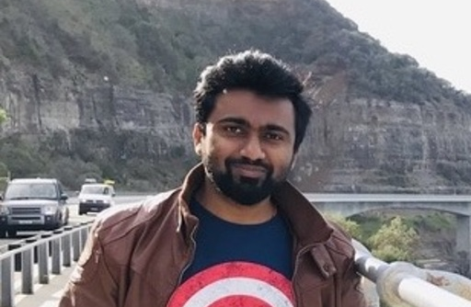
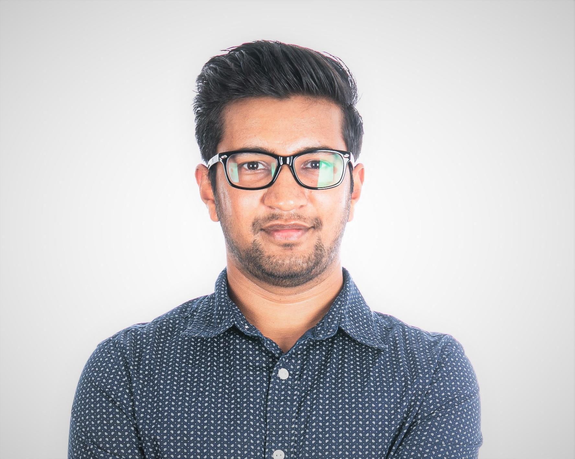
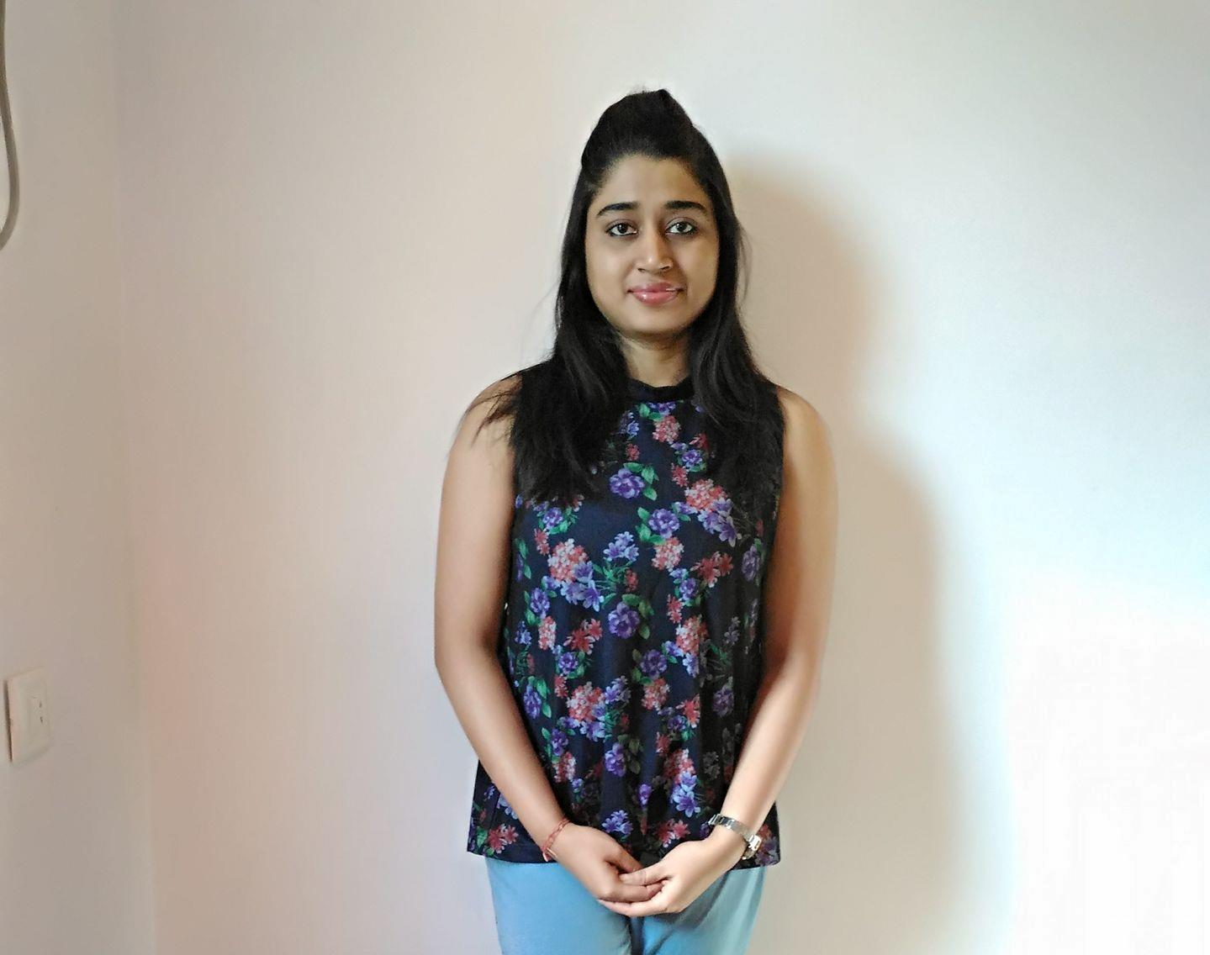
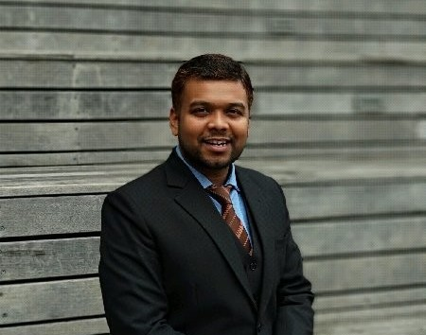
Saurabh Jain
https://www.linkedin.com/in/saurabh-jain-68040952
Jubin Savla
https://www.linkedin.com/in/savlajubin
Saket Jain
https://www.linkedin.com/in/saketj32
Anikesh Sasmal
https://www.linkedin.com/in/anikesh-sasmal-20031988
Swetalina Nayak

Slide 3
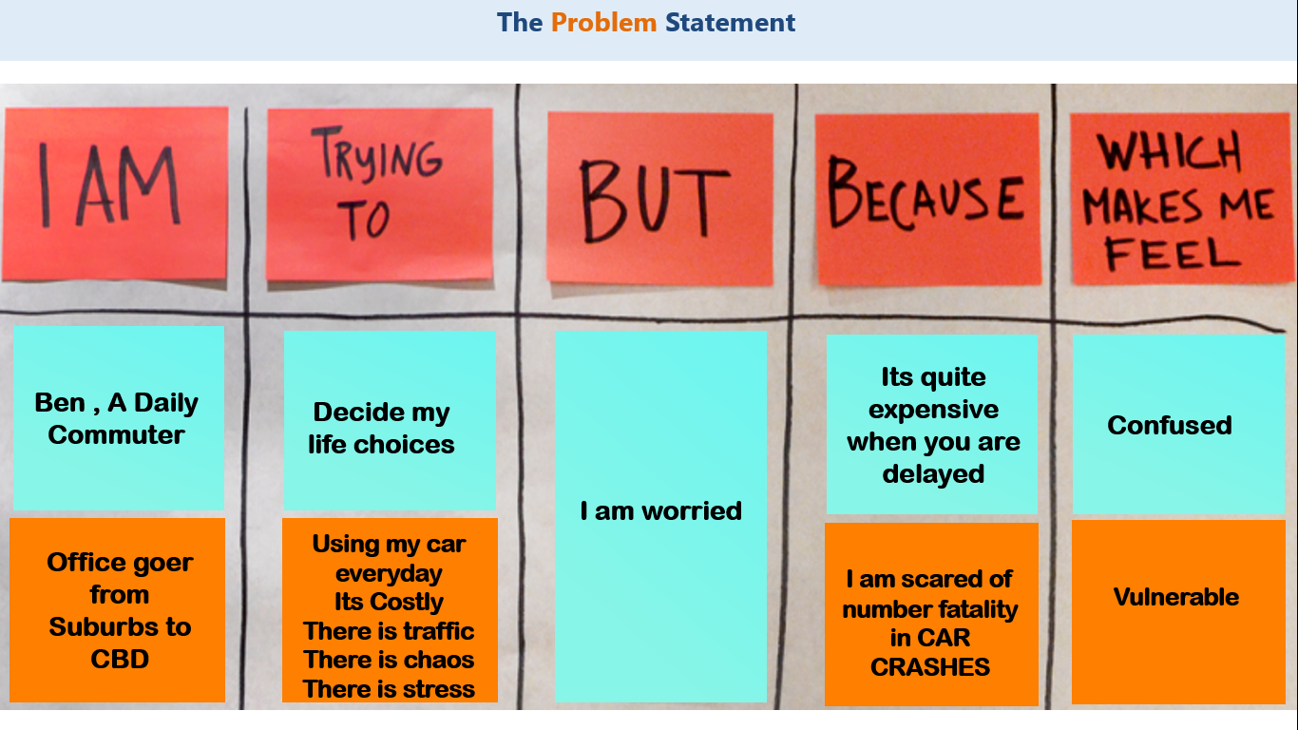

Slide 4


The Design - From chaotic energy to PREDICTIVE precision
An Experience Innovation.
Can Government Organisation provide him support ? Can we leverage exiting PTV app to help him predict ?
Ben needs help to understand what is his life choices ? What he truly desires ?
DESIRABILITY
VIABILITY
PEOPLE
BUSINESS
FEASIBILITY
TECHNOLOGY
Can open data available provide Ben meaningful insights and choices he wants to make?
Notes:
Ki: A packaged solution for the SMEs and large businesses that leverages the power of Artificial Intelligence, mobility solutions, virtual reality, MANA and IoT to reduce the loss of revenue due to machine failures and hasten the process of machine repair with precision and accuracy.
Do: Infosys must apply design thinking principles to design the product and then leverage the skillset of Infoscions from units of mobility (native app programming), Data and Analytics (MANA and AI) and Infosys Labs (for virtual reality and IoT). The product will be sold to SMEs without MANA and AI features to reduce the cost for SMEs. Large businesses and manufacturers of machines can leverage MANA and AI features by paying extra for these premium features.
Ai: This way, we can unite the powers of AI, MANA, IoT, mobility and virtual reality to create a seamless experience for the engineers at SMEs and large business while addressing machine failures, thus saving time, money and productivity of industries.

Slide 5
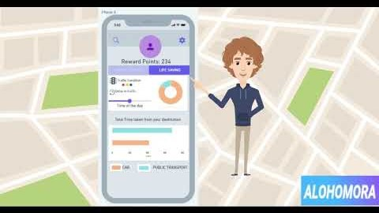
The Journey – How Ben is astonished ?
https://youtu.be/ufSkkEI8sOU

Slide 6
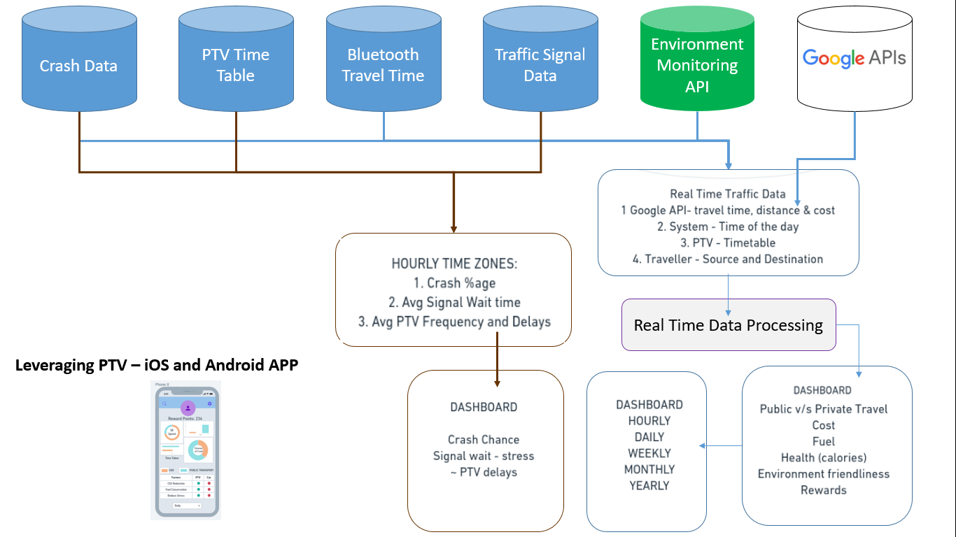
What happened at the backend
Real Time Data Source
Real Time Data Processing based on Ben’s location and time in its system
PTV App leveraged to inform Ben his Daily route information CAR vs PT,
Savings he can make
Digital Angel on his side – Predict Crash
Ben making planet better
Ben becoming healthy

Slide 7
UX
DESIGN
Defining Experiences…

Slide 8
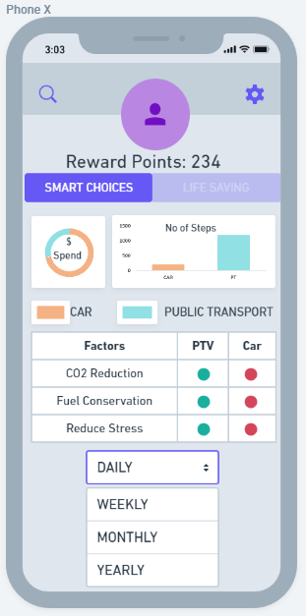
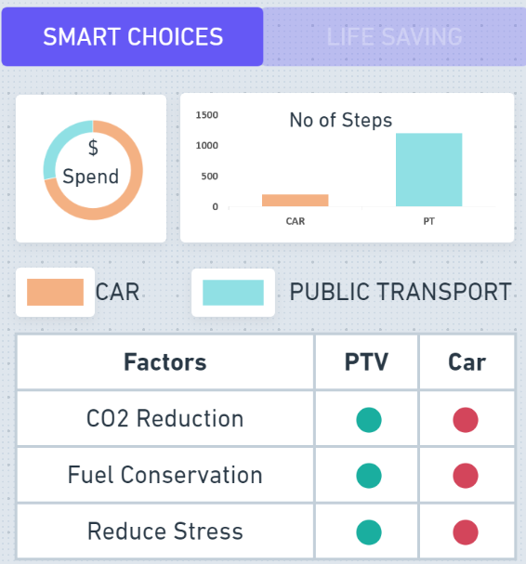
Ben’s Smart Choices

Slide 9
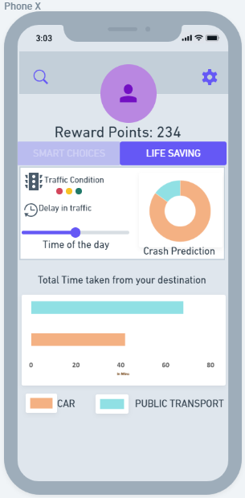
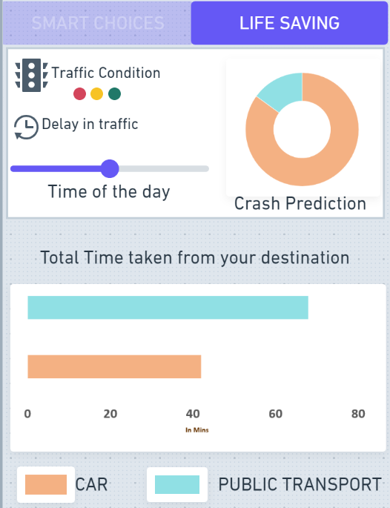
Ben’s Digital Angel

Slide 10
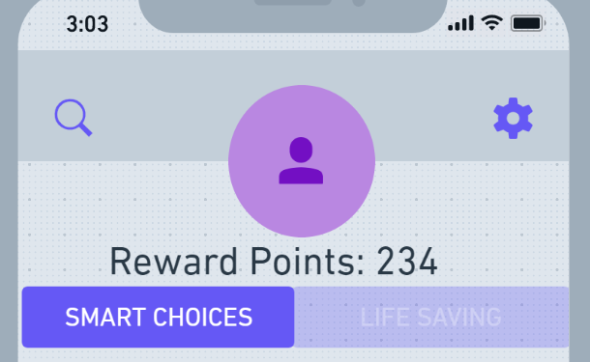
Endless Possibilities – Can we scale
PT Usage Rewards
Emergency
Co Commuter Chat
Environment point to point CO2 Check
Possibilities

Slide 11
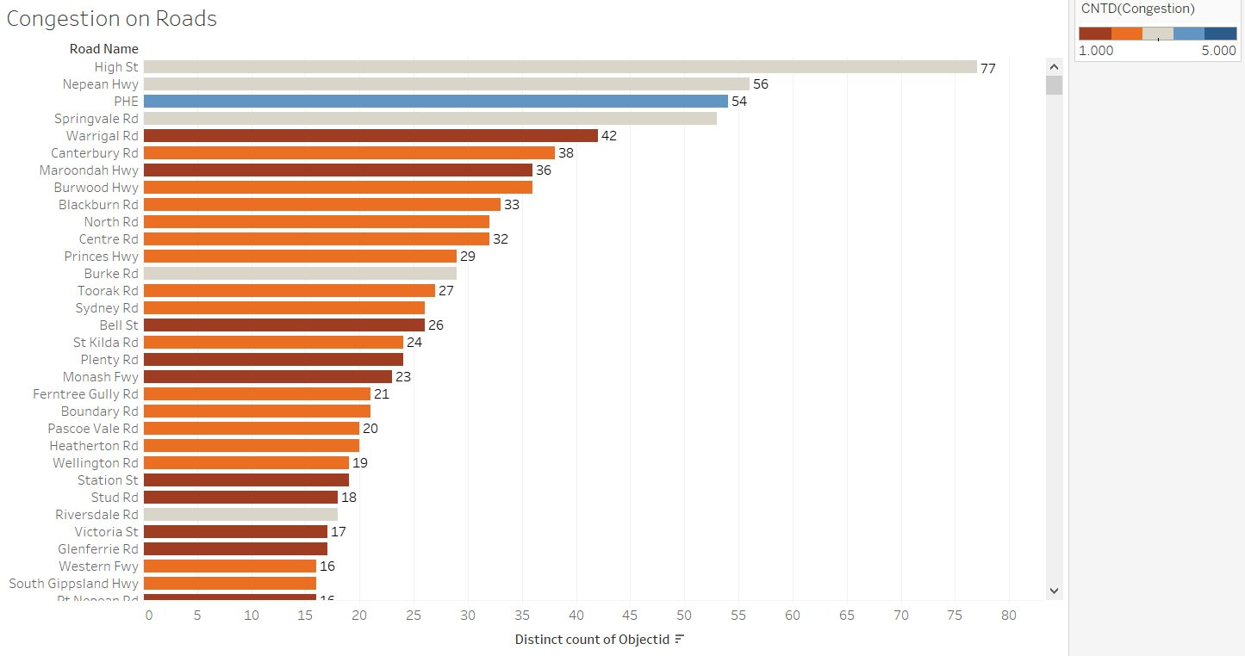
Appendix

Slide 12
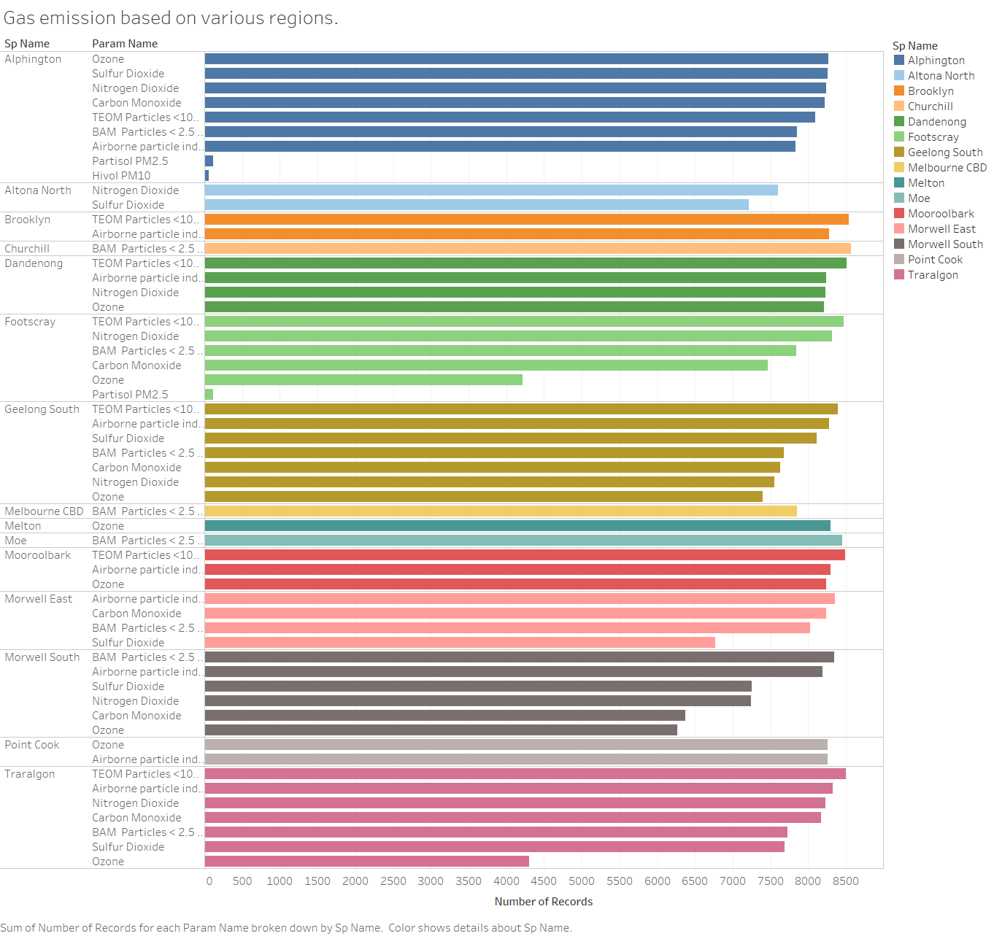

Slide 13
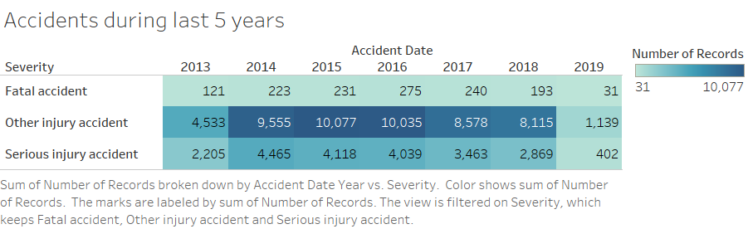
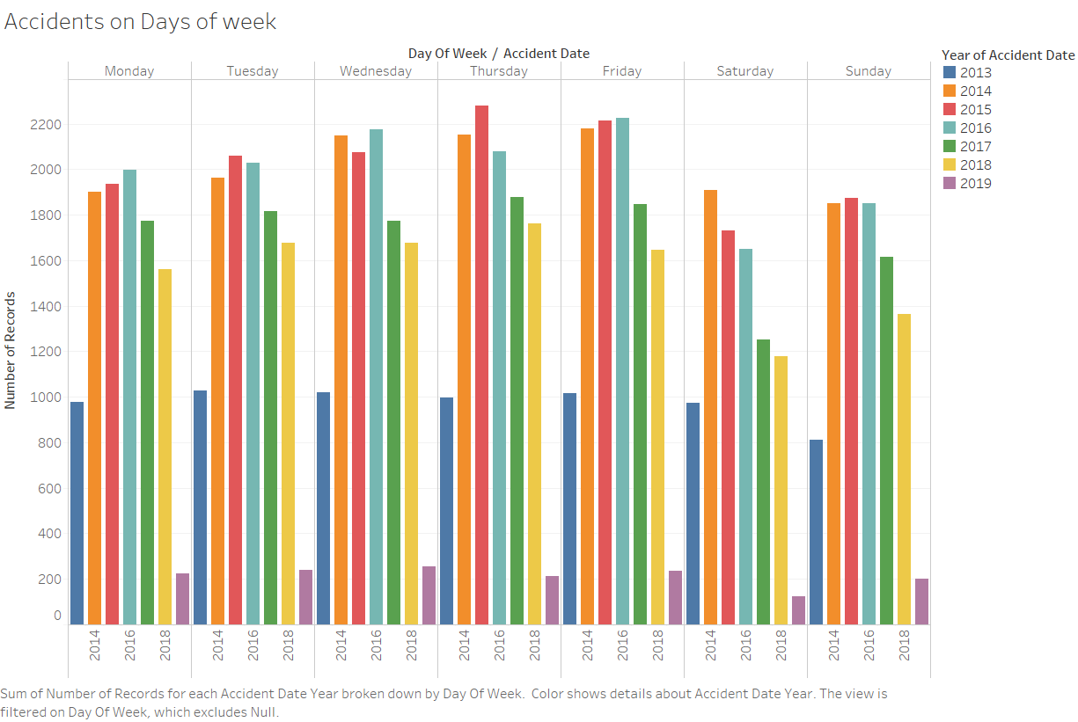

Slide 14
Thank You #StaySafe

